Slide 1


A CROSS-SECTIONAL STUDY ON KNOWLEDGE, ATTITUDE, AND PRACTICE OF STUDENTS REGARDING ANTIBIOTIC MISUSE
Project Work submitted to the Rajiv Gandhi University of Health Sciences, Bengaluru, Karnataka
SUBMITTED BY
SHEERAZ AHAMED (22P3288) SHAHEEN N V (22P3287) ARPAN KUNDU (22P3283)
SYED SHADAB ABBAS (22P3292) SIVA KUMAR N (21P1994)
In partial fulfilment of the requirements for the degree of
BACHELOR OF PHARMACY
In PHARMACOVIGILANCE
Under the guidance of Dr. SWATHI RAMESH

Slide 2
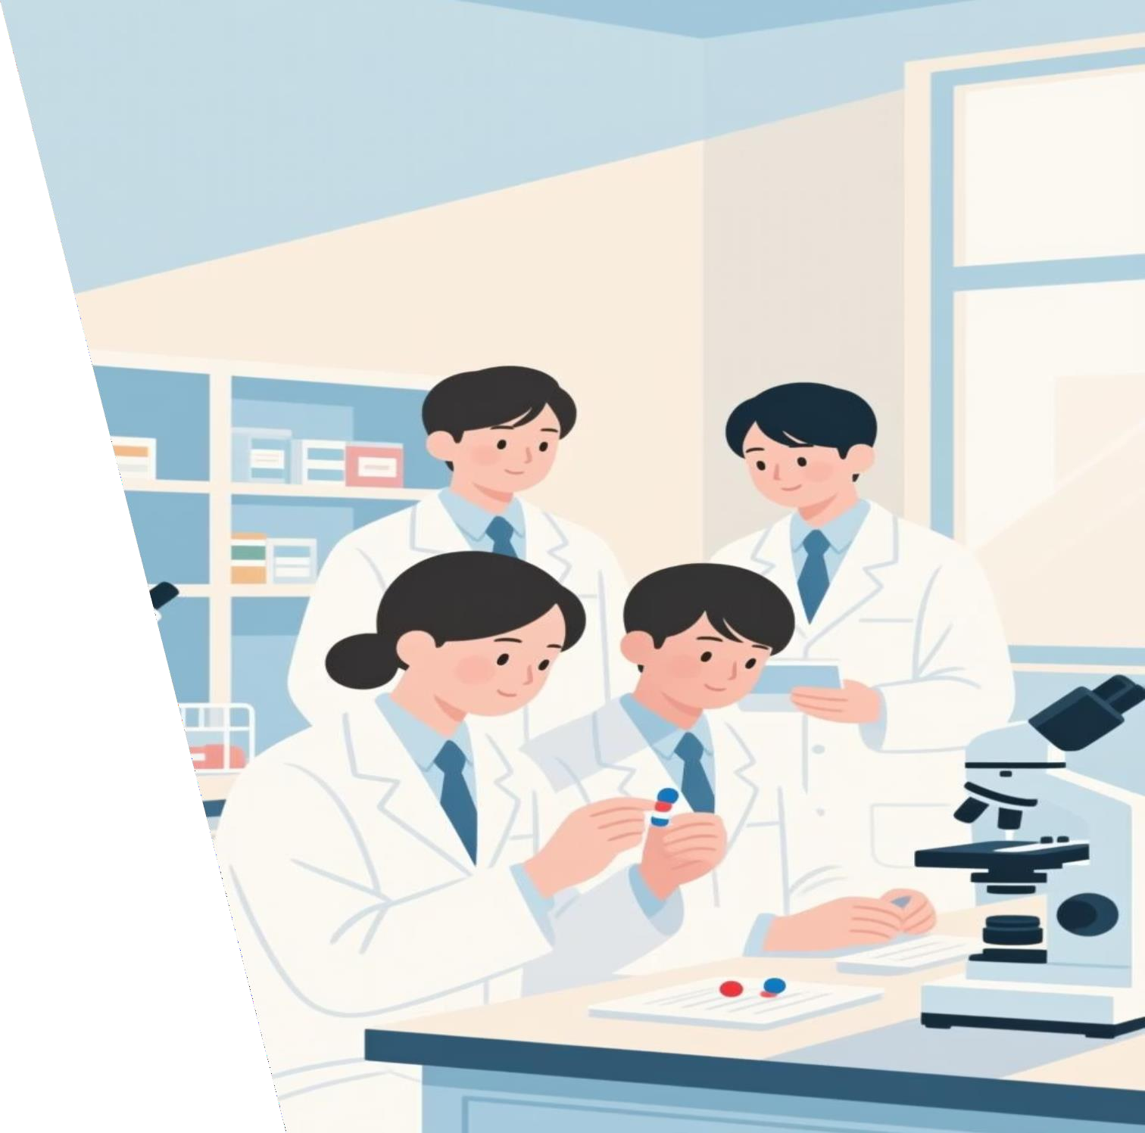
A Cross-Sectional Study on Knowledge, Attitude and Practice of Students Regarding Antibiotic Misuse
Sheeraz Ahamed, Shaheen N V Arpan Kundu Syed Shadab Abbas
Siva Kumar N
Krupanidhi College of Pharmacy, Rajiv Gandhi University of Health Sciences

Slide 3
TABLE OF CONTENTS
Introduction
Need for the study
Review of literature
Aim
Objectives
Methodology
Results and discussion
Conclusion
References

Slide 4

INTRODUCTION
Antibiotics are crucial medicines used to treat bacterial infections and have saved millions of lives worldwide.
Misuse and overuse of antibiotics have become a serious global health issue.
Studies show that about 50% of antibiotics are used incorrectly or without proper medical advice
Such misuse leads to antibiotic resistance, making infections harder and more expensive to treat.
Around 1 in 3 patients stop taking antibiotics before completing the full course, leading to incomplete
treatment

Slide 5

The Antibiotic Crisis: Why This Research Matters
The Promise
The Threat
Antibiotics revolutionized modern medicine, transforming fatal bacterial infections into treatable conditions and drastically reducing mortality from infectious diseases
Antibiotic misuse has triggered antimicrobial resistance (AMR), a global health crisis that threatens to undermine decades of medical progress and create untreatable infections.

Slide 6

The Critical Role of Antibiotics in Modern Healthcare
Antibiotics treat bacterial infections ranging from mild respiratory tract infections to life-threatening sepsis. Beyond direct infection treatment, antibiotics manage secondary bacterial complications in viral diseases—such as bacterial pneumonia in COVID-19 patients. Proper and timely antibiotic use saves lives and reduces disease burden, yet their therapeutic potential depends on responsible stewardship
Respiratory Infections
Urinary Tract infections
Sepsis & Life-threatening infections
Post-surgical complications

Slide 7
NEED FOR THE STUDY
Antibiotic Resistance:
Overuse and misuse of antibiotics are the main drivers of antimicrobial resistance . Studying misuse helps identify patterns that contribute to resistant bacterial strains, which make infections harder to treat.
Public Health Threat:
WHO recognizes antibiotic resistance as one of the top global health threats.
Understanding misuse helps design interventions to protect public health and
reduce mortality from resistant infections.
Awareness and Behavioral Insights:
Many people self-medicate or discontinue antibiotics early. Studying these behaviors highlights the need for better education and awareness campaigns.
Policy and Guideline Development:
Data from such studies support policymakers in creating stricter regulations for antibiotic sale, prescription, and public awareness initiative

Slide 8
REVIEW OF LITERATURE
S. No | First Author | Year | Title | Key Result
1. | Ganguly N, et al. | 2011 | Antibiotic Use in India and Its Role in Resistance | Widespread and unregulated broad-spectrum antibiotic use has fueled resistance. Advocates for national antibiotic policies, stewardship, protocols favoring narrow-spectrum agents, and educational efforts for prescribers/public.
2. | Napolitano F, et al. | 2013 | Public Knowledge and Attitudes Toward Antibiotics in Italy | Many understand misuse causes resistance but misconceptions (e.g., using antibiotics for viral illnesses) persist. Recommends ongoing public campaigns to correct misunderstandings and promote responsible use.
3. | Scaioli G, et al. | 2015 | Knowledge, attitudes, and practices regarding antibiotics among Italian medical students | Found high awareness about resistance, but persistent misconceptions and self-medication. Emphasizes education must address both knowledge and responsible prescribing behaviors.

Slide 9
S. No | First Author | Year | Title | Key Result
4. | Higuita- Gutiérrez LF, et al. | 2020 | Attitudes and knowledge of antibiotic use among Colombian medical students | Satisfactory attitudes but limited practical knowledge. Students lacked confidence in appropriate antibiotic indications. Recommends integrating targeted training on resistance and rational use into medical education.
5. | Bianco A, et al. | 2020 | Antibiotic Knowledge and Practices in Public and Students | Reports poor knowledge and inappropriate practices (self- medication, unwarranted demand) regarding antibiotics. Stresses the need for broad-based education and stricter dispensing policies.
6. | ElMahi O, et al. | 2021 | Self-medication with antibiotics among Sudanese medical students | High prevalence of self-medication due to limited knowledge and training. Medical students underestimated misuse risks. Recommends integrating antibiotic stewardship and rational prescribing into curricula for improved future practice

Slide 10
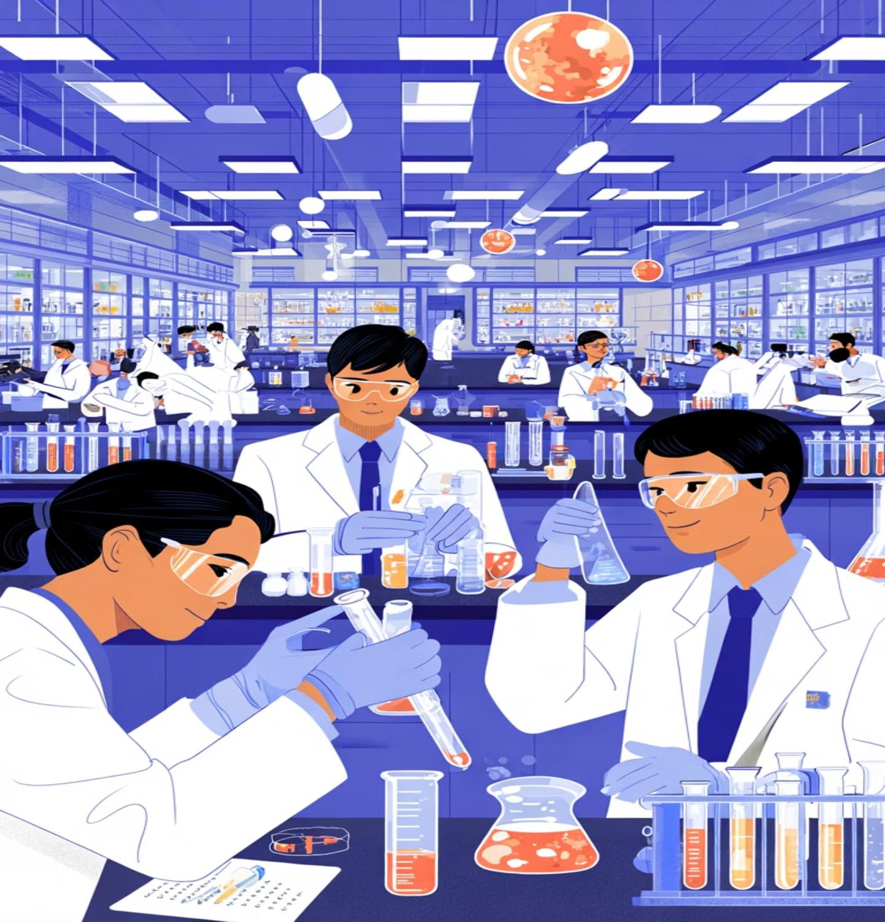
AIM
TO ASSESS KNOWLEDGE, ATTITUDE, AND PRACTICE OF STUDENTS REGARDING ANTIBIOTIC MISUSE : A CROSS-SECTIONAL INVESTIGATIONAL STUDY AMONG STUDENTS OF KRUPANIDHI GROUP OF INSTITUTIONS

Slide 11
OBJECTIVE
To evaluate the level of knowledge of students about the appropriate and
inappropriate use of antibiotics.
To assess the attitudes of students towards antibiotic use, self-medication, and resistance.
To examine the common practices of students in relation to antibiotic
consumption, storage, and sharing.
To identify factors influencing the misuse of antibiotics among students.
To provide baseline data that may guide educational interventions and awareness programs to promote rational antibiotic use

Slide 12
METHODOLOGY
Study design: A cross-sectional study
Study Period: July 2025- September 2025
Study Site: Krupanidhi group of institutions
[Pharmacy, Physiotherapy, Nursing]
Study Population: 380
Inclusion criteria:
Undergraduate and Postgraduate students of both genders who are willing to participate in the study
Pharmacy, Physiotherapy, Nursing Students.
Exclusion criteria:
Students unwilling to participate in the study.
Students under 18 years are not eligible.

Slide 13
METHODOLOGY
A Cross–sectional study was conducted in Krupanidhi group of institutions situated in Bengaluru.
All the study participates who met the inclusion criteria were enrolled within the study. The aim of the study was explained to the students.
The questionnaires were given to students and asked them to fill out to assess their Knowledge, Attitude, and Practice. Educational interventions were given verbally C by a PowerPoint presentation to the students.
Knowledge, Attitude, and Practice of students regarding antibiotic misuse among students of Krupanidhi group of institutions (Pharmacy, Physiotherapy, Nursing, specifically). The assessment was established by subjecting the response data to descriptive statistical analysis.

Slide 14

RESULT & DISCUSSION

Slide 15
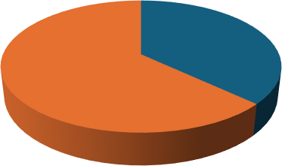
SOCIO-DEMOGRAPHICS DETAILS:
Age
Gender
N
80
70
60
Male Female
50
40
N
GT%
30
20
10
0
Among the total respondents, 62.9% were female and 36.8% were male, while a very small proportion preferred not to disclose their gender. This indicates that female students were more actively involved in responding to the survey compared to their male counterparts, which may reflect the higher enrollment of female students in health-related courses in the surveyed colleges
19
20
21
22
23
24
Total: 380 students in the prototype structure, consistent with a young adult cohort predominantly in the early stages of higher education

Slide 16
Course
Pharmacy Nursing
Physiotherapy
Out of 380 respondents, 77.9% were pharmacy students, 12.6% were from nursing, and 9.5% from physiotherapy. This distribution reflects the academic diversity within the healthcare field, with pharmacy students forming the dominant group. Their curriculum exposure to pharmacology and therapeutics could influence their higher baseline knowledge of antibiotics compared to other health disciplines.

Slide 17
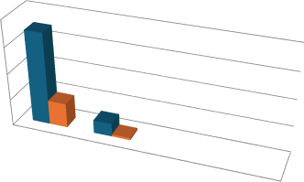
KNOWLEDGE ON ANTIBIOTICS:
2. Have you heard about Antibiotics resistance? | Count of 2 Have you heard about Antibiotics resistance?? | GT% Count of 2 Have you heard about Antibiotics resistance?
Yes | 350 | 92.1%
No | 50 | 7.9%
Total | 380 | 100%
1. Do you know about Antibiotics? | Count of 1 Do you know about Antibiotics? | GT% Count of 1 Do you know about Antibiotics?
Yes | 376 | 98.9%
No | 4 | 1.1%
Total | 380 | 100%
400
300
200
100
0
400
N
GT%
300
200
N
Yes
100
GT%
No
0
Yes
No
Yes 350 (92.1%); No 30 (7.9%); N=380.Data-Analysis- Fr
High awareness of resistance reflects successful dissemination of the concept through curricula and public discourse; nonetheless, subsequent practices (e.g., use for viral illnesses, early discontinuation, sharing) indicate that the “meaning” of resistance is not integrated into day-to-day decision-making, highlighting an awareness–behavior
Yes 376 (98.9%); No 4 (1.1%); N=380.Data-Analysis- Freq-Graphs
Near-universal familiarity suggests that foundational awareness is not the limiting factor; rather, the challenge lies in correcting misbeliefs about when to initiate therapy, appropriate duration, and the consequences of indiscriminate use, which require targeted, practice- oriented education

Slide 18
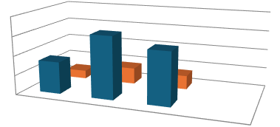
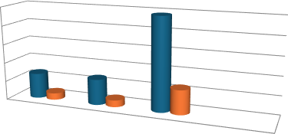
3. Do you think Antibiotics cure all type of infections? | Count of 3 Do you think Antibiotics cure all type of infections? | GT% Count of 3 Do you think Antibiotics cure all type of infections?
Yes | 83 | 21.8%
No | 161 | 42.4%
May be | 136 | 35.8%
Total | 380 | 100%
4. When do you think taking Antibiotics is necessary? | Count of 4 When do you think taking Antibiotics is necessary? | GT% Count of 4 When do you think taking Antibiotics is necessary?
Whenever ill | 67 | 17.6%
Severe illness | 68 | 17.9%
Bacterial infection | 245 | 64.5%
Total | 380 | 100%
250
200
150
100
50
0
200
150
N GT%
100
50
0
N
GT%
GT%
Yes
No
N
Whenever ill
Severe illness
Bacterial infection
Bacterial infection 245 (64.5%); Severe illness 68 (17.9%);
Whenever ill 67 (17.6%); N=380.Data-Analysis-Freq-Graphs
About two-thirds of the students knew that antibiotics are meant to treat bacterial infections. But the remaining one-third thought antibiotics should be used for any serious illness, no matter the cause. This belief — that “stronger diseases need stronger medicines” — can lead to wrong use of antibiotics for viral infections, non-infectious problems, or illnesses that get better on their own
May be
Yes 83 (21.8%); No 161 (42.4%); Maybe 136
(35.8%); N=380.Data-Analysis-Freq-Graphs.
With 57.6% either believing antibiotics cure all infections or uncertain, there is a prominent conceptual gap regarding etiology-specific use; this creates a cognitive pathway to unnecessary initiation for non-bacterial illnesses and exacerbates selection pressure even in mild community syndromes.

Slide 19
5. Do you think Antibiotics can be used for viral infections also?
6. Do you think Antibiotics affect stomach's good bacteria?
6. Do you think Antibiotics affect stomach's good bacteria? | Count of 6 Do you think Antibiotics affect stomach's good bacteria? | GT% Count of 6 Do you think Antibiotics affect stomach's good bacteria?
Yes | 149 | 39.2%
No | 91 | 23.9%
May be | 140 | 36.8%
Total | 380 | 100%
5. Do you think Antibiotics can be used for viral infections also? | Count of 5 Do you think Antibiotics can be used for viral infections also? | GT% Count of 5 Do you think Antibiotics can be used for viral infections also?
Yes | 160 | 42.1%
No | 107 | 28.2%
May be | 113 | 29.7%
Total | 380 | 100%
K6
Yes 160 (42.1%); No 107 (28.2%); Maybe 113 (29.7%); N=380.Data-Analysis-Freq-Graphs.
Yes 149 (39.2%); No 91 (23.9%); Maybe 140 (36.8%); N=380.Data-Analysis-Freq-Graphs.
About 71.8% of people answered “yes” or “maybe” when asked if antibiotics should be used for common colds, sore throats, or flu-like illnesses. This shows a major misunderstanding — one that leads many to wrongly use antibiotics for viral infections. It also explains why many later reported using antibiotics on their own for these conditions, making this a key area to focus on for improving antibiotic use.
Many people don’t understand how antibiotics can harm the body’s natural bacteria (microbiome), and they’re unsure about these effects. Because these harms aren’t obvious, they don’t see much risk in starting antibiotics on their own, sharing them with others, or stopping the course early — even if they know about antibiotic resistance.

Slide 20
7. What do you think is the duration of the course of Antibiotics? | N | GT%
1-2 days | 88 | 23.2%
3-5 days | 172 | 45.3%
7-14 days | 51 | 13.4%
Until the disease is cured | 69 | 18.2%
Total | 380 | 100%
8. Which of the following Antibiotics have you last used for any infection? | N | GT%
Azithromycin | 152 | 40%
Cefixime | 35 | 9.2%
Amoxycillin | 83 | 21.8%
Ofloxacin | 52 | 13.7%
Norfloxacin | 5 | 1.3%
Don’t know | 53 | 13.9%
Total | 380 | 100%
Azithromycin was the most used antibiotic (40%), followed by Amoxicillin (21.8%), Ofloxacin (13.7%), Cefixime (9.2%), and Norfloxacin (1.3%). Notably, 13.9% of respondents couldn’t recall the antibiotic name, showing gaps in prescription awareness and possible self-medication without proper knowledge. This highlights Azithromycin’s dominance and concerns about antibiotic use habits
Most students (45.3%) thought antibiotic treatment should last 3–5 days, while others varied—23.2% said 1–2 days, 13.4% said 7–14 days, and 18.2% said until the disease is cured. This shows confusion about the right treatment length. Most prefer short courses (up to 5 days), often stopping based on symptoms rather than medical guidelines, which may cause early stopping or overuse of antibiotics.
Preferences cluster around short courses (≤5 days, 68.5%), consistent with a symptom-driven stopping rule rather than pathogen- and guideline-driven durations; this preference likely interacts with early discontinuation behaviors and perceived rapid relief.

Slide 21
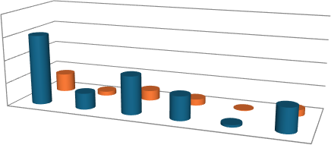
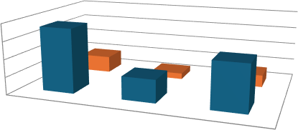
ATTITUDE:
10. Do you prefer Doctor to prescribe Antibiotics whenever you are ill?
9. Which of the following Antibiotics have you last used for any infection?
200
150
100
50
0
200
150
N
GT%
100
N
50
0
GT%
GT%
GT% N
Yes
N
No
Sometimes
Yes 184 (48.4%); Sometimes 131 (34.5%); No 65 (17.1%);
N=380.Data-Analysis-Freq-Graphs.
More than 80% of people said they often prefer to take antibiotics when they’re sick. This strong preference creates pressure on doctors to prescribe antibiotics, especially in places where patients feel that getting medicine means proper treatment — even if antibiotics aren’t actually needed
Azithromycin 152 (40.0%); Amoxycillin 83 (21.8%); Ofloxacin 52 (13.7%); Cefixime
35 (9.2%); Norfloxacin 5 (1.3%); Don’t know 53 (13.9%);
People commonly use antibiotics from several major groups — macrolides, penicillins, fluoroquinolones, and cephalosporins. This wide use of broad-spectrum antibiotics, along with habits like taking short courses or sharing medicines, increases the risk of bacteria developing resistance in the community.

Slide 22
11. Which do you think is better, IV therapy or oral antibiotics? | N | GT%
Oral Antibiotics | 111 | 29.2%
IV Therapy | 76 | 20%
Depends on illness | 193 | 50.8%
Total | 380 | 100%
12. What could be the reason people don't complete the course of Antibiotics? | N | GT%
High price of medication | 79 | 20.8%
Cure of particular disease | 103 | 27.1%
Negligence | 131 | 34.5%
Lack of knowledge | 140 | 36.8%
Total | 453 | 119.2%
About half the students (50.8%) said antibiotic choice depends on illness type or severity. Meanwhile, 29.2% preferred oral antibiotics and 20% preferred IV therapy. This shows some students understand the need to tailor treatment, but others may have fixed, oversimplified views on the best route, possibly misunderstanding drug potency and indications.
Most common reasons for not completing antibiotics were lack of knowledge (36.8%) and negligence (34.5%), followed by feeling cured early (27.1%) and high medicine cost (20.8%). This shows education and behavior are bigger issues than finances, highlighting the need for better awareness and counseling to improve adherence

Slide 23
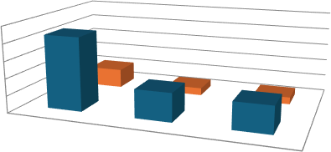
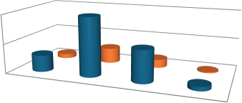
PRACTICE AND BEHAVIOURS:
.Do you keep Antibiotics at home for emergency need?. | Count of 22 Do you keep Antibiotics at home for emergency need? | GT% Count of 22 Do you keep Antibiotics at home for emergency need?
Yes | 217 | 57.1%
No | 84 | 22.1%
Sometimes | 79 | 20.8%
Total | 380 | 100%
. Do you take Antibiotics without consulting the Doctor? | Count of 17 Do you take Antibiotics without consulting the Doctor? | GT% Count of 17 Do you take Antibiotics without consulting the Doctor?
Yes | 57 | 15%
No | 200 | 52.6%
Sometimes | 109 | 28.7%
Oftenly | 14 | 3.7%
Total | 380 | 100%
250
200
150
100
50
0
200
N
100
N
GT%
GT%
GT%
0
GT%
Yes
N
Yes
N
No
Sometimes
No
Oftenly
Sometimes
Yes 57 (15.0%); Often 14 (3.7%); Sometimes 109 (28.7%); No 200 (52.6
Yes 217 (57.1%); Sometimes 79 (20.8%); No 83
(21.8%); N=380.Data-Analysis
Around 80% of people keep antibiotics at home at least sometimes. This makes it easy for them to start taking antibiotics on their own, share them with others, or use leftovers from incomplete courses. To prevent this kind of misuse, proper storage and safe disposal practices need to be promoted.
Almost half of the participants used antibiotics without a doctor’s advice at least sometimes. Those who did this often seemed to believe they could manage infections on their own. This habit may be strengthened by the quick relief they feel after taking
antibiotics, even when the use isn’t appropriate.

Slide 24
Have you taken more doses of Antibiotic than prescribed ever? | N | GT%
Yes | 44 | 11.6%
No | 303 | 79.7%
Sometimes | 33 | 8.7%
Total | 380 | 100%
Have you used leftover Antibiotics ever for the same cases? | N | GT%
Yes | 71 | 18.7%
No | 254 | 66.8%
Sometimes | 55 | 14.5%
Total | 380 | 100%
About one-third of students reused leftover antibiotics, with 18.7% admitting regular reuse and 14.5% sometimes doing so. This shows poor adherence to prescriptions and fragmented care, leading to incomplete treatments and increased risk of resistance. Leftover use reflects and worsens the problem of shortened antibiotic courses and stockpiling.
Most students (79.7%) followed prescribed doses, but 11.6% admitted to taking more, and 8.7% sometimes did. This risky practice may come from thinking higher doses speed recovery but can cause harm and increase antibiotic resistance

Slide 25
Have you consumed peer's/other's Antibiotics for similar symptoms/illness? | N | GT%
Yes | 66 | 17.4%
No | 234 | 61.6%
Sometimes | 80 | 21.1%
Total | 380 | 100%
Which of the following Antibiotics you have consumed till now? | N | GT%
Azithromycin | 179 | 47.1%
Ofloxacin | 74 | 19.5%
Cefixime | 66 | 17.4%
Norfloxacin | 34 | 8.9%
Amoxycillin | 129 | 33.9%
All of the above | 54 | 14.2%
Total | 536 | 141%
Nearly 40% of students have used antibiotics prescribed for others, with 17.4% admitting regular use and 21.1% sometimes doing so. This risky behavior bypasses proper diagnosis and promotes symptom-based treatment instead of individualized care, highlighting misuse outside medical supervision
Azithromycin was the most used antibiotic (47.1%), followed by Amoxicillin (33.9%), Ofloxacin (19.5%), Cefixime (17.4%), and Norfloxacin (8.9%). Some students (14.2%) used all these antibiotic types, showing wide exposure and frequent use. This broad antibiotic use raises concerns about overuse and resistance risk in the community

Slide 26
Have you discontinued Antibiotics before the completion of prescribed duration of course? | N | GT%
Yes | 116 | 30.5%
No | 184 | 48.4%
Sometimes | 80 | 21.1%
Total | 380 | 100%
For which of the following illness you usually consume Antibiotics without consulting a doctor? | N | GT%
Common cold | 188 | 49.5%
Throat Infection | 148 | 38.9%
Stomach Infection | 51 | 13.4%
Diarrhoea/Dysentry | 40 | 10.5%
I don’t | 59 | 15.6%
Total | 486 | 127.9%
Most common self-medicated illnesses were common cold (49.5%) and throat infections (38.9%), followed by stomach infections (13.4%) and diarrhea (10.5%). About 15.6% never self-medicated. This shows many use antibiotics wrongly, especially for viral illnesses, contributing to resistance.
Out of 380 students, 48.4% always completed their antibiotic course, while 30.5% stopped early and 21.1% sometimes did. This means over half didn’t fully finish treatment, risking incomplete infection clearance and increased resistance due to symptom-based stopping rather than following guidelines

Slide 27
DISCUSSION
High Awareness, Low Understanding: While nearly 99% of Indian students were aware of antibiotics, over 70%
incorrectly believed they could be used for viral infections (a key misconception).
Rampant Misuse Practices: Inappropriate practices were common: nearly half admitted to self-medicating, and over 50% discontinued courses prematurely. These rates were notably higher than those reported among Italian medical students.
Strong Demand for Prescription: Almost half of the Indian students desired a doctor to prescribe antibiotics every time they were sick, showing a strong, expectation-driven demand that influences prescribing.
Influence of Regulation: The high misuse in India is partly attributed to the widespread availability of antibiotics without a prescription, in contrast to the strict prescription-only policy in Italy.
Need for Multi-Pronged Action: A multipronged strategy is required, focusing on strict enforcement of prescription policies and structured educational campaigns for all students, not just medical ones

Slide 28
CONCLUSION
The study highlights a concerning gap between knowledge and
practice among healthcare students. Despite possessing
adequate knowledge, inappropriate antibiotic use persists.
These findings underscore the need for targeted educational
interventions and behavioral change strategies within healthcare curricula to promote responsible antibiotic use and combat future
antimicrobial resistance.
·The overall study results indicate that knowledge scored 52.2%,
attitude 20.5%, and practice 27.3%.
However, during the pre-study, 68.7% of students had no idea
about Antibiotic resistance. Following this, a presentation was
delivered on bacteria developing resistance to Antibiotics.

Slide 29
REFERENCES
LIN, Jun, et al. Mechanisms of antibiotic resistance, Frontiers in Microbiology, 2015, 6. https://doi.org/10.3389/fmicb.2015.00034
GANGULY, Nirmal, et al. Rationalizing antibiotic use to limit antibiotic resistance in India+. sThe Indian Journal of Medical Research, 2011, 134: 281-294.
https://pubmed.ncbi.nlm.nih.gov/21985810
BARKER, Anna, et al. What drives Inappropriate antibiotic dispensing? A mixed-methods study of pharmacy employee. perspectives in Haryana, India. BMJ Open, 2017, 7.
https://doi.org/10.1136/bmjopen-2016-013190
PORTER, Gillian; GRILLS, Nathan. Medication misuse in India: a major public health issue in India. Journal of public health, 2016, 38 2: e150-7. https://doi.org/10.1093/pubmed/fdv072
BIANCO, Aida, et al. Knowledge and practices regarding antibiotics use. Evolution, Medicine, and Public Health, 2020, 2020: 129-138.
https://doi.org/10.1093/emph/eoaa028
NAPOLITANO, Francesco, et al. Public Knowledge, Attitudes, and Experience Regarding the Use of Antibiotics in Italy. PLoS ONE, 2013, 8.
https://doi.org/10.1371/journal.pone.0084177

Slide 30


